Slide 1


A confident European digital economy in a global context
Prague
14/10/13
Jean-Jacques Sahel

Slide 2

Digital value
Harmonious digital society
Information economy

Slide 3
A. Digital value: the information century
Growth prospects over the long term
Productivity impact of online platforms in 2012 was €210bn
Europe’s App economy: 794k jobs, € 10bn revenues /yr
Cloud’s cumulative impact on GDP : EUR 957 billion, and 3.8 million jobs by 2020
Digital Single Market: +5% EU GDP and 4 million jobs
Digital economy grows 10% a year, and contributes to 20% in productivity growth overall
Average annual growth rate of potential output, in per cent
Source: OECD Economic Outlook 93 long-term database, Sept 2013
Per cent of labour force
Source: OECD National Accounts database; Eurostat.

Slide 4
B. A harmonious digital society
“The Internet offers opportunities to extend and value cultural diversity within the global village.”
Vivian Reding

Slide 5
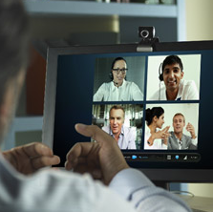
B. A harmonious digital society
> ICT skills: bedrock of Internet-enabled society and economy
Digital literacy and critical thinking essential in the modern world
77% of jobs will require technical skills
Digital skills will be a must for 9 jobs out of 10
900,000 unfilled vacancies for ICT specialists by 2015
Need to step up efforts for the next generation of tech-savvy entrepreneurs, promoting digital skills and tech-driven teaching in schools
(MS Shape the Future / Office for Edu; Partners in Learning ; Dreamspark; Lifelong learning - SENSEN)

Slide 6

B. A harmonious digital society
> enhancing trust in a data-driven world
Need to continuously enhance user privacy and security
Nurturing the data-driven economy (open data, big data,…)
Striking the balance: innovating in a safe , secure and trusted digital environment

Slide 7

C. An information economy: fostering a confident European digital economy in a global context
> The Internet, fast
Digital society and knowledge economy require fast Internet connectivity
Vibrant telecom competition key to network investment
Making innovative, efficient use of (spectrum) resources

Slide 8

C. An information economy: fostering a confident European digital economy in a global context
> Digital Single Market
Toward a single telecom market
Information society and audiovisual media services need better single market

Slide 9
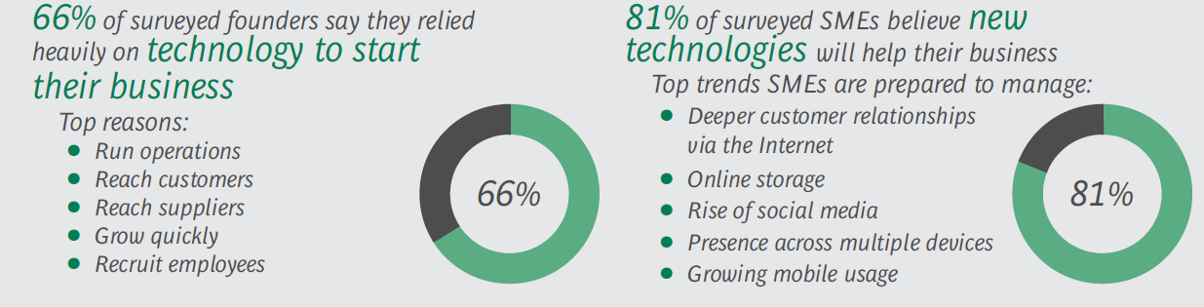
99% of EU companies are SMEs

Slide 10
C. An information economy: fostering a confident European digital economy in a global context
> Embracing digital entrepreneurship and innovation in Europe
A mindset change
Access to technology, including broadband Internet
Easier access to finance
R&D, university-industry links
Skills for entrepreneurs
Government driven incentives to SMEs, inc. reducing red tape
Pro-innovation, pro-entrepreneurship policy and regulation, inc. net neutrality
(MS Microsoft Innov Centres in Brno, Hradec Kralove, soon Prague; Bizspark)

Slide 11
C. An information economy: fostering a confident European digital economy in a global context
> Rise to the cloud
Efficiencies
Saving of 150-200 billion; +0.5% productivity growth over 5 years for Europe’s public sector
More tailored, adaptive and responsive services
A place for world-leading EU companies
‘Killer app’ of the Internet ecosystem
(2.07m cloud jobs in EMEA (twice more than North America) across industries)

Slide 12

C. An information economy: fostering a confident European digital economy in a global context
> The digital world is global
Trade
Free flow of information and data across borders
Open markets
Forward-thinking regulation
The right conditions for entrepreneurship

Slide 13
The right mix
Foster a harmonious digital society
Boost ICT skills and education
Enhanced trust and privacy
Embrace the cloud and data-driven economy
Facilitate the diffusion of information and new technology
‘Nurturing’ policies for open, innovative and competitive markets, including a true digital single market
An entrepreneurial, open mindset

Slide 14

more at microsoft.cz and microsoft.eu
© 2013 Microsoft Corporation. All rights reserved. Microsoft, Windows and other product names are or may be registered trademarks and/or trademarks in the U.S. and/or other countries.
The information herein is for informational purposes only and represents the current view of Microsoft Corporation as of the date of this presentation. Because Microsoft must respond to changing market conditions, it should not be interpreted to be a commitment on the part of Microsoft, and Microsoft cannot guarantee the accuracy of any information provided after the date of this presentation.
MICROSOFT MAKES NO WARRANTIES, EXPRESS, IMPLIED OR STATUTORY, AS TO THE INFORMATION IN THIS PRESENTATION.

