Slide 1

5G is Now, Sailing to New eMBB Horizons
Jakub Borkowski

Slide 2



The Intelligent Revolution Will Profoundly Impact Every Person, Home and Organization
Helping special people live a normal life: Guide helmets for the visually impaired
Helping people acquire special capabilities: Multi-language communication, AI cameras
90% of smart device users will use intelligent personal assistants
At-home services: Healthcare robots, education robots
Home everywhere: Holographic communication, smart home
12% of homes will use intelligent service robots
Personalization at scale: Customized Harley-Davidson manufacturing
Smart government: Safe City, smart government services
86% of enterprises will use AI
Persons
Homes
Organizations
Data source: Huawei GlV 2025
Notes:
智能社会将深刻地影响每个人、每个家庭、每个组织。
**********************************
Slide Owner: Liu Xueshi （00257362）, Corporate Marketing
Latest update: Jan, 2018
Recommended target audience: all
**********************************

Slide 3
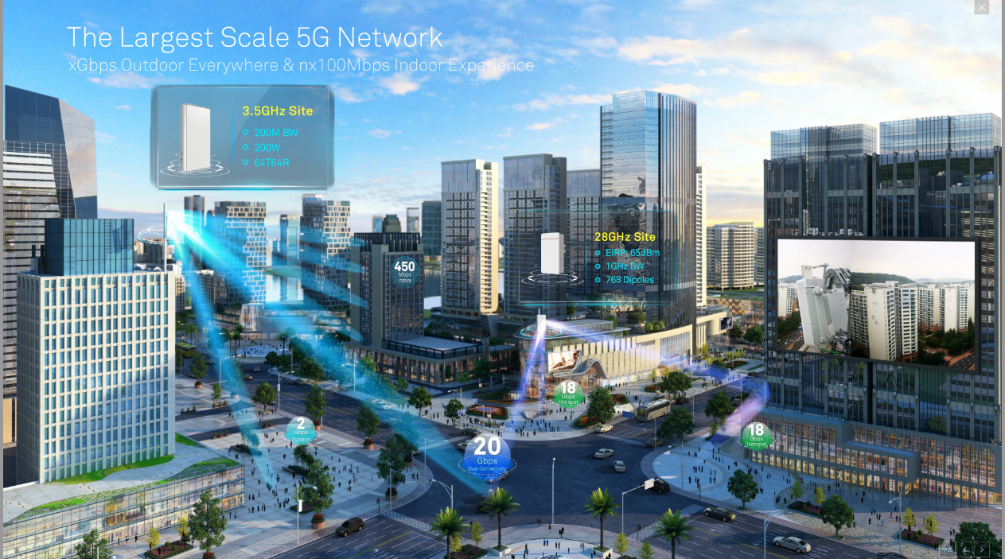


Slide 4
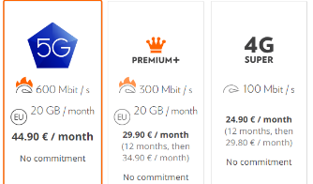
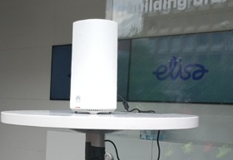
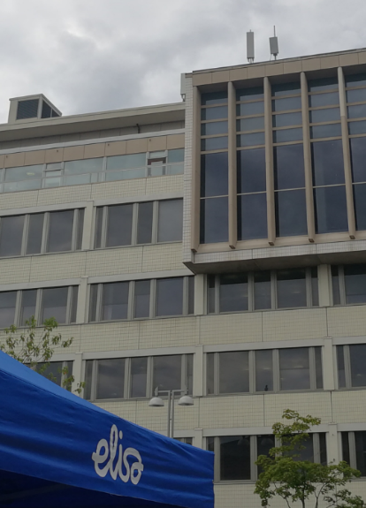
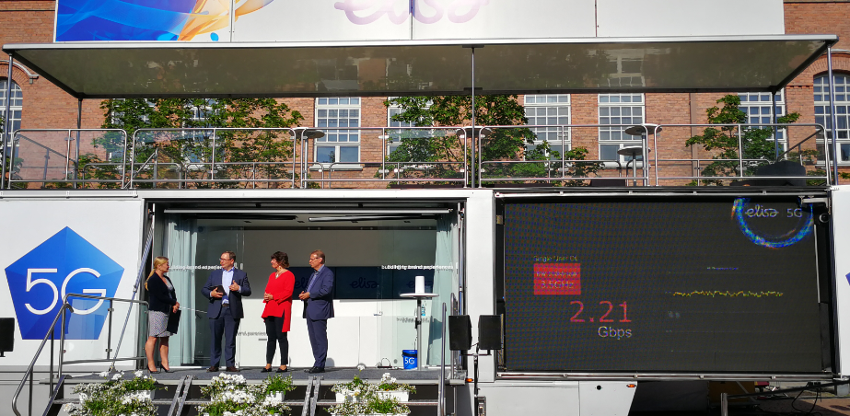
Finland Elisa 5G- Worlds First Commercial Launch @ 27 June 2018

Slide 5

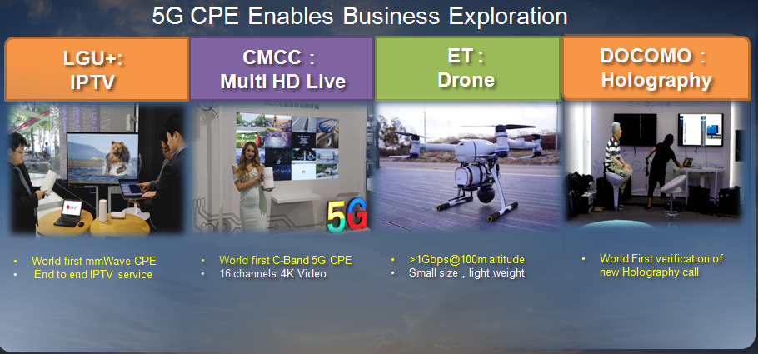


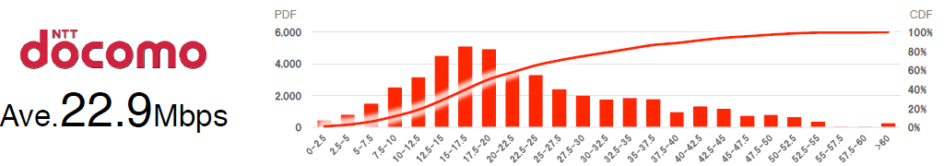


100Mbps Everywhere is Benchmark to Deliver Better Video Experience
100Mbps satisfy most applications
5G target: Ave. speed 100Mbps
Current
LTE
4K Video
(15~20Mbps)
4K/8K Video
(15~100Mbps)
8K Video
(60~80Mbps)
PDF
CDF
5G
eMBB Target
Ave.100Mbps
Glass Free 3D Video
(50~100Mbps)
HD 360° Video
(80~100Mbps)
Mbps
Source: Huawei Wireless X Labs
Notes:
云化AI 是未来，需要一个平台和一个管道。
50Mbps, 10ms可以保障不论你在任何地方，都能享受一致性的MBB体验。（50Mbps可以满足99%应用）
因此5M,NB-IOT是数字社会的基石， 50M+全联接智能社会的基石

Slide 6

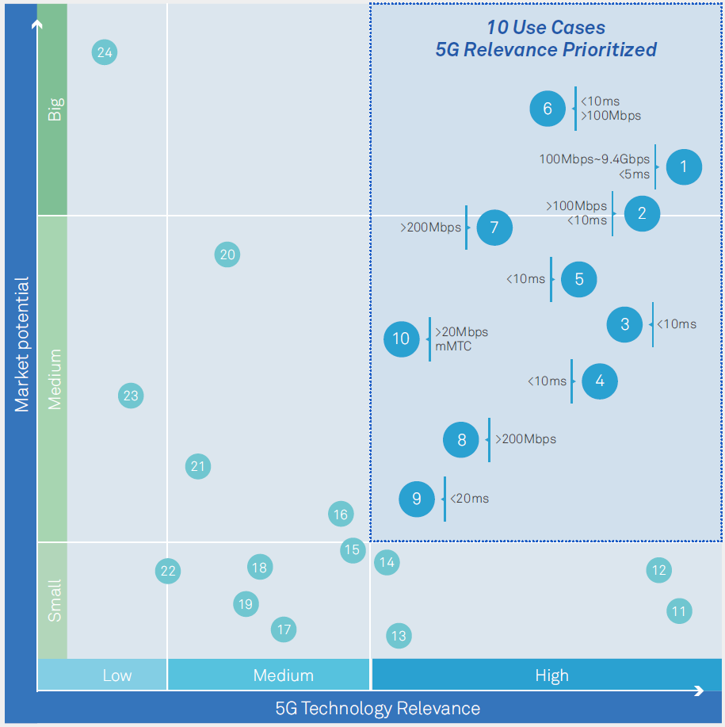
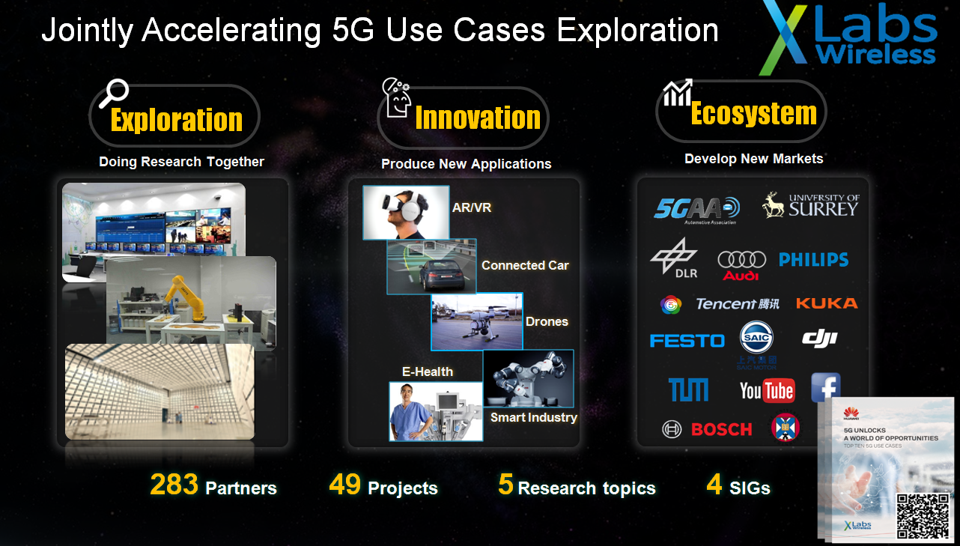
Top 10 5G Use Cases & Network Requirements
1. Cloud Virtual & Augmented Reality -Real-time Computer Rendering Gaming/Modeling
2. Connected Automotive -ToD, Platooning, Autonomous Driving
3. Smart Manufacturing -Cloud Based Wireless Robot Control
4. Connected Energy -Feeder Automation
5. Wireless eHealth -Remote Diagnosis With Force-Feedback
6. Wireless Home Entertainment -UHD 8K Video & Cloud Gaming
7. Connected Drones -Professional Inspection & Security
8. Social Networks -UHD/Panoramic Live Broadcasting
9. Personal AI Assistant -AI Assisted Smart Helmet
10. Smart City -AI-enabled Video Surveillance
11. Hologram
12. Wireless eHealth – Remote Surgery
13. Wireless eHealth – Ambulance Communication
14. Smart manufacturing – Industrial Sensors
15. Wearable – UHD Body Camera
16. Drone – Media
17. Smart manufacturing – Cloud Based AGV
18. Home – Service Robotics (Cloud AI Assisted)
19. Drone – Logistics 20. Drone – Fly Taxi
21. Wireless eHealth – Hospital Nursing Robot
22. Home – Home Surveillance
23. Smart Manufacturing – Logistics & Inventory Monitoring
24. Smart City – Trash Bin, Parking, Lighting, Traffic Light, Meters
http://www.huawei.com/en/industry-insights/mbb-2020/trends-insights/5g-unlocks-a-world-of-opportunities
Notes:
http://3ms.huawei.com/mm/docMaintain/mmMaintain.do?method=showMMDetail&f_id=1773635&for_statistic_rec=rec_msl_content_related
1. Cloud Virtual & Augmented Reality -Real-time Computer Rendering Gaming/Modeling
2. Connected Automotive -ToD, Platooning, Autonomous Driving
3. Smart Manufacturing -Cloud Based Wireless Robot Control
4. Connected Energy -Feeder Automation
5. Wireless eHealth -Remote Diagnosis With Force-Feedback
6. Wireless Home Entertainment -UHD 8K Video & Cloud Gaming
7. Connected Drones -Professional Inspection & Security
8. Social Networks -UHD/Panoramic Live Broadcasting
9. Personal AI Assistant -AI Assisted Smart Helmet
10. Smart City -AI-enabled Video Surveillance
11. Hologram
12. Wireless eHealth – Remote Surgery
13. Wireless eHealth – Ambulance Communication
14. Smart manufacturing – Industrial Sensors
15. Wearable – UHD Body Camera
16. Drone – Media
17. Smart manufacturing – Cloud Based AGV
18. Home – Service Robotics (Cloud AI Assisted)
19. Drone – Logistics 20. Drone – Fly Taxi
21. Wireless eHealth – Hospital Nursing Robot
22. Home – Home Surveillance
23. Smart Manufacturing – Logistics & Inventory Monitoring
24. Smart City – Trash Bin, Parking, Lighting, Traffic Light, Meters

Slide 7
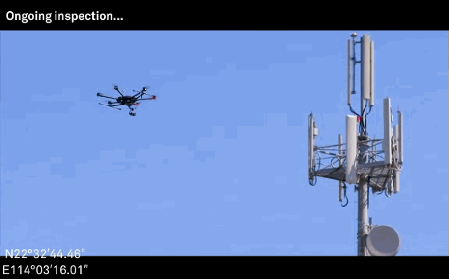
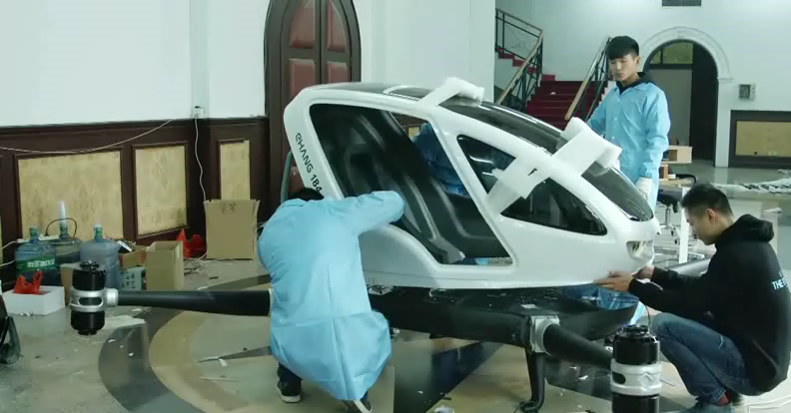







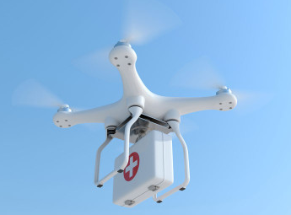
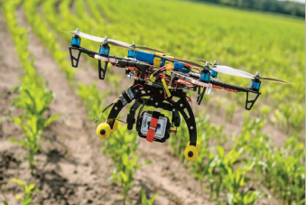
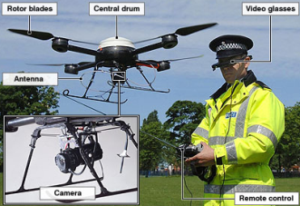
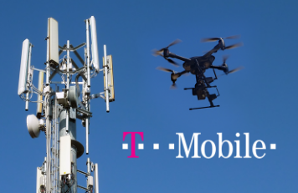

Jointly Efforts in Exploring More Applications of Connected Drone
Routine Inspections of Site
Drone Taxi
Transport
Entertainment
Agriculture
Security
Telecommunication

Slide 8
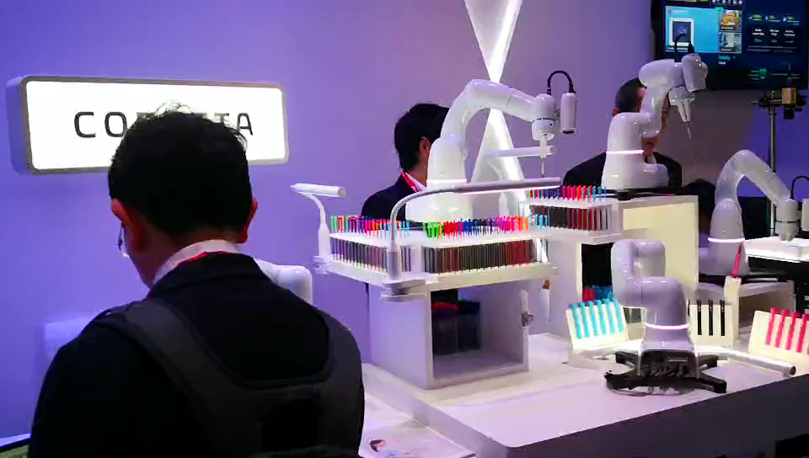
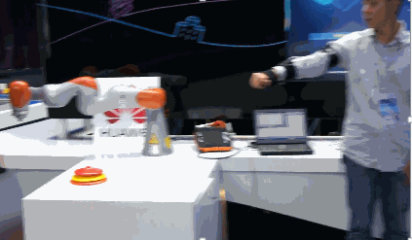



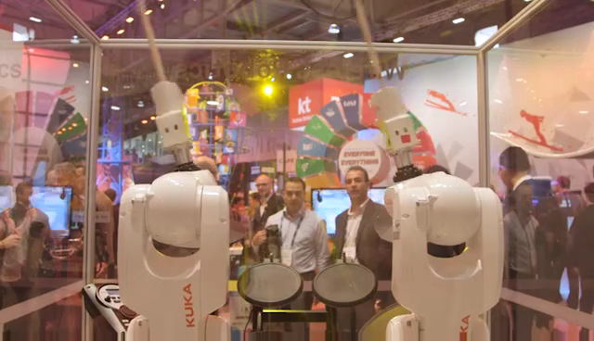
Use Cases of Smart Manufacturing
Flexible Manufacturing
Remote Control of Robotic Arm
Smart Manufacturing Network Requirement:
Industrial cameras upload real-time images to the cloud for identification, bandwidth requirements >100mbps
Robotic arm coordinated control, delay requirement <10ms
Notes:
Connected Drones-----<5G-unlocks-a-world-of-opportunities-v3> Page19-21

Slide 9
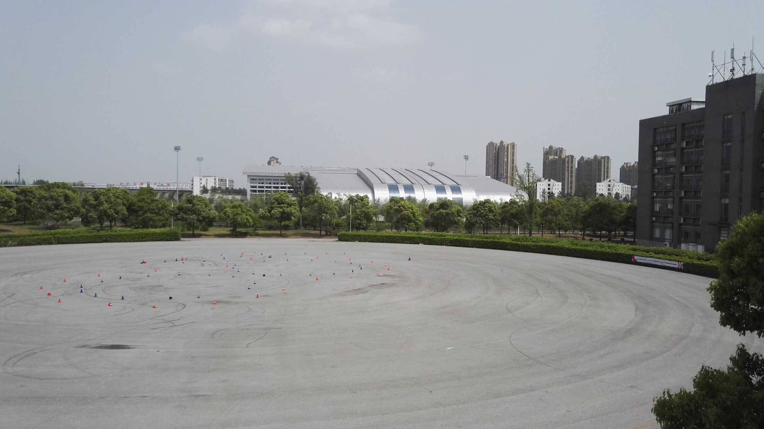


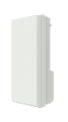
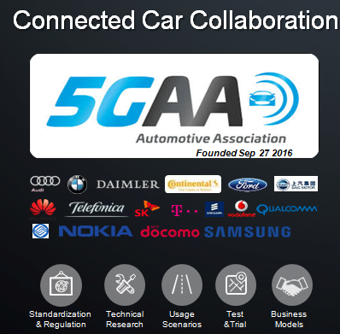
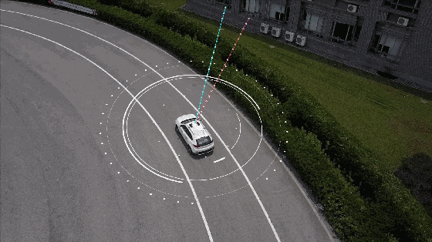
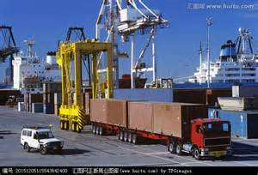
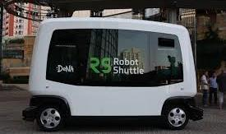
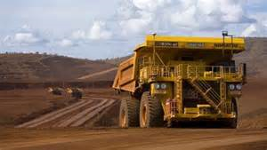
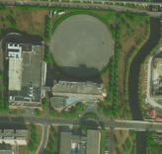
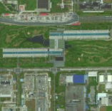


5G NR Based Tele-operated Driving(ToD) Trial
10ms
E2E Latency
0.12m Break Distance
5G NR
50Mbps
For HD FoV Uploading
UL Live Video
Transmission
DL Remote Control
Application Scenario
Load truck
Shuttle bus
Mine truck
52.3 km
Jiading
Shanghai
5G
SHOWROOM
Car & Cameras
Remote Control

Slide 10

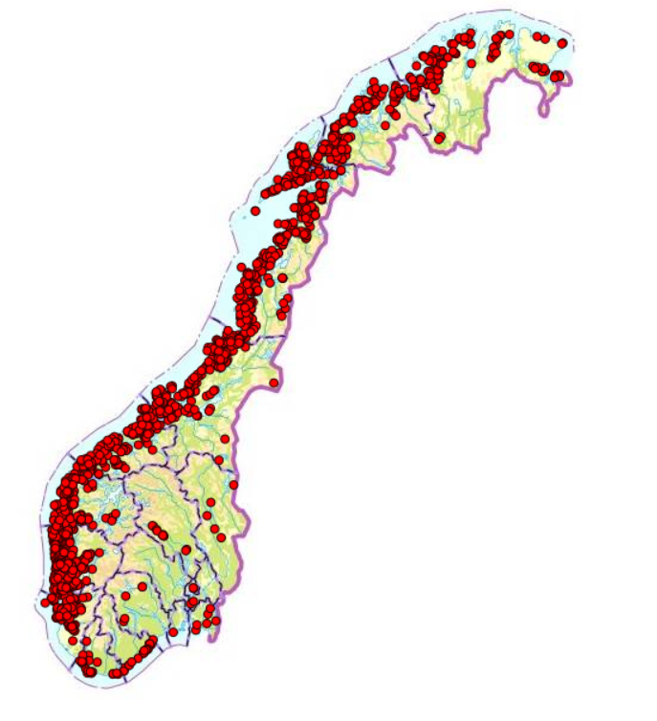

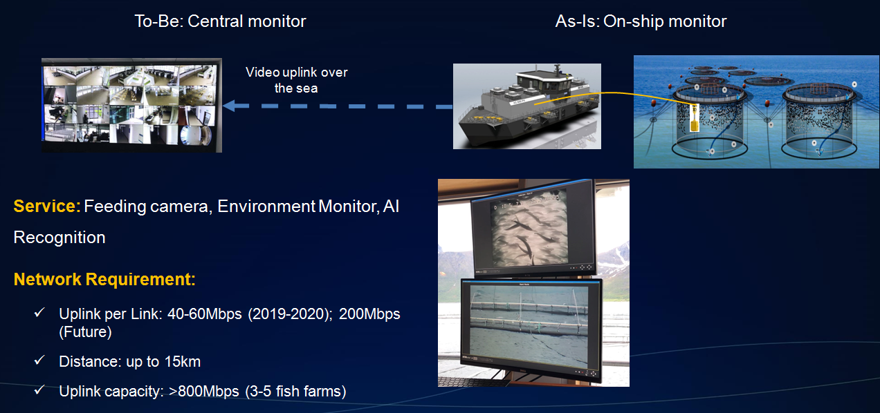
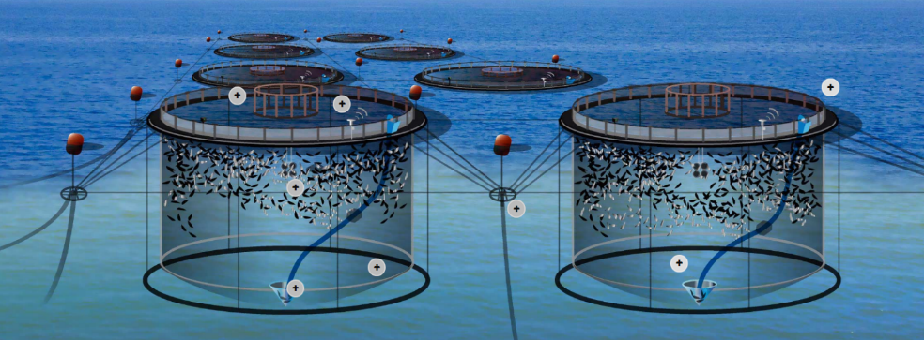
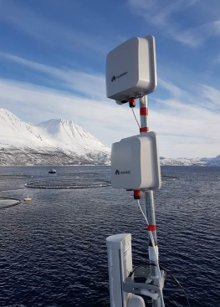
5G- Powered Fish Farm with Telenor Norway
1300+ Fish Farm Locations in Norway
5G Antenna Solution
Notes:
渔业是Norway继石油之后的第二大产业。有大约150家渔业公司，挪威西北部沿海有超过1300个三文鱼场，其中最大的十家占整个产业revenue的69%（2015）
挪威渔业2016年出口价值80亿USD，2017年产出120万吨三文鱼，出口95%。当前渔场的EBITDA Margin 高达58%。同时，政府计划渔业规模在未来会继续扩大3-4倍，2050年渔业将成为超越石油的支柱型产业

Slide 11
Service Experience Requirement Evolution
PHASE1
2018-2019
PHASE2
2020-2022
PHASE3
2022~
Latency
Advanced Video Driven
4k Video
Pre-VR
40ms
Hologram
10Gbps
FWA
30ms
8k Video / Entry VR
25ms
Ultimate VR
1Gbps
Advance VR
500Mbps
HD360 Live
200Mbps
Drone
>50Mbps
Camera Driven
DL Speed
VR Gaming
120Mbps
ToD
25 ~30 Mbps
FWA-IPTV
70Mbps
VR Live Events
100Mbps
Advance VR
20ms
Ultimate VR
eHealth
10ms
V2X
3~5ms
Smart Energy
Robot control
1~2ms
Surveillance 1K
10 Mbps
UL Speed
FWA
5Mbps
Strategy Focus
Service: FWA
Capability: DL Speed
Network: Fixed/ Nomadic
Strategy Focus
Service: FWA/ eMBB, Public
Capability: Capacity & UL Enhancement
Network: Nomadic/ Mobile
Strategy Focus
Service: eMBB/ uRLLC/ start of mMTC
Capability: Ultimate DL/UL, Low latency
Network: Full Fledged 5G
~100Mbps
<40ms
~500Mbps
<20ms
<1Gbps
<10ms

Slide 12












Europe 5G Commercialization Plan
2018
H2
2019
2020
H1
H1
H2
H1
H2
Finland
Trial
Pre-commercial
(10 Sites)
200+ Deployment
(Top 10 cities)
UK
Trial
Commercial
(500 Sites)
1500 Sites
Germany
Trial
Pre-commercial
(30 Sites)
Commercial
Sweden
Demo
Trial
Pre-Commercial
Hungary
Demo
Trial
Pre-Commercial
Norway
Trial
Fish Farm
Commercial
(300+ Sites)
1000 Sites by 2020Q1

Slide 13



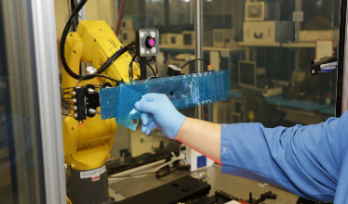










In Summary, 5G Brings the Smart Networking Closer
Food agriculture
& Bio-tech
  Health, Wellness
  & Bio-med
Smart devices, Robotics & Mechatronics
Digital, IoT& Embedded Technology
Creative, Culture & High Value Services
Smart Networking, it’s Time for CHANGE
.
Cloud
Water/Gas
Automobile
5G
Sensors
Big Data & AI
Municipal
Man-machine
Interfaces
Asset
Environment
Agriculture
Energy
5G will Enable the Digitalization for All Industries
Notes:
从全球5G发展趋势来看，5G是未来，中东区域当前需做好政策制定及商业、生态的孵化，如频谱的规划、站点资源的准备，同时基于4G网络培育5G商业应用和催熟产业链，推进整个产业生态有序的、可持续的发展，迎接5G时代到来！
From the perspective of the global 5G development trend, 5G is the future. Middle East area currently needs to make policy formulation and commercial and ecological incubations, such as spectrum planning and site resource preparation. At the same time, based on the 4G network, it nurtures 5G commercial applications and mature industrial chains, push the whole industry moving forward orderly and sustainably, to embrace the arrival of 5G era!

Slide 14

















European 5G Spectrum Overview: C-Band & 700MHz & mmWave
2018
2019
···
Already Released
2020
H1
H2
H1
H2
UK
ES
DE
FR
IT
C-Band
(3.5G&3.7G)
NO
CZ
RO
HU
SK
LT
LV
FI
AT
SE
DK
GR
PL
700MHz
DE
FR
UK
IT
FI
IS
DK
NO
SE
RO
PL
AT
HU
mmWave
SE
PL
AT
*：Unlisted countries do not publish plan yet

Slide 15


Efficient Spectrum Strategy
Ultra Experience Layer
(WTTX/AR/VR, HD Video)
LTE-Evolution
5G NR Major Cities
Nationwide 5G NR
2019-2020
2021-2022
2023-2025
mmWave
5G super experience layer
Home broadband access
Self-backhaul
1
mmWave
5G NR (for Hotspots)
C-Band (3.5GHz)
5G NR (Major Cities)
C-band
5G primary band
Massive MIMO for capacity & coverage
2600MHz
LTE Evolution
High Capacity Layer
(Video/AR/VR)
2300MHz
LTE Evolution
2100MHz
UMTS
LTE Evolution
LTE Evolution/5G NR
2
5G Anchor (2.1 GHz)
Extend C-band coverage by UL/DL decoupling
1800MHz
LTE Evolution
Ubiquitous Coverage Layer
(VoLTE/IoT)
900MHz
GSM/UMTS
GSM/LTE Evolution
800MHz
LTE Evolution
700 MHz
IoT, deep coverage, ubiquitous experience
3
700MHz
5G NR

Slide 16
L/NR Spectrum Cloudification
LTE/NR CloudAIR
Sharing Based on Resource Block
CloudAIR is fundamental for
UL/DL Decoupling feature
Time
Sharing Ratio: 90%
3.5G DL PDSCH Coverage
3.5G UL PUSCH Coverage
13.7dB Gap
Bottleneck
Frequency
3.5GHz with Weak Coverage
.
Uplink is Bottleneck
NR RB
LTE RB
Notes:
WID--

Slide 17
Thank you

